Slide 1
Serverless CI/CD with Tekton and Argo CD
Submitted By – Team #1
Vamsi Krishna Yepuri
Venkata Kalyan Polamarasetty

Slide 2




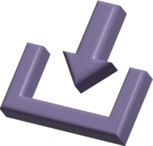









CI/CD
Fetch
Test
Build & Package
Upload
Developers
Artifact Repository Servers
Version Control
Build Servers (CI Server)
End users
Production Servers
Deploy Server (CD server)

Slide 3
Problem Statement
Challenges with Traditional CI/CD
rely on virtual machines (VMs)
Infrastructure Management ( require provisioning, management, and scaling)
Longer Provisioning Time
Overhead and Resource Utilization
Complexity in Cross-Platform Builds and Deployment
Over costs

Slide 4
Abstract
Project Development
Containerized softwares and application
Containerized serverless CI/CD
Deployment to Kubernetes
Study
Benefits : portability, deployment, resource utilization, startup times, scalability , flexibility, lower costs

Slide 5
Serverless CI/CD

Slide 6
Literature Review
Papers | Microservices | Stateless | Container | Kubernetes | Polyglot
1 | ✓ | ✗ | ✓ | ✓ | ✗
2 | ✗ | ✗ | ✓ | ✓ | ✗
3 | ✗ | ✗ | ✓ | ✗ | ✗
4 | ✓ | ✗ | ✓ | ✗ | ✗
5 | ✓ | ✗ | ✓ | ✗ | ✓
Ours | ✓ | ✓ | ✓ | ✓ | ✓

Slide 7
Milestones
Milestone 1 : Setting up Kubernetes on cloud
Milestone 2 : Setting up Tools
Milestone 3 : Creating serverless CI/CD pipelines
Milestone 4 : Deployment with Argo CD

Slide 8
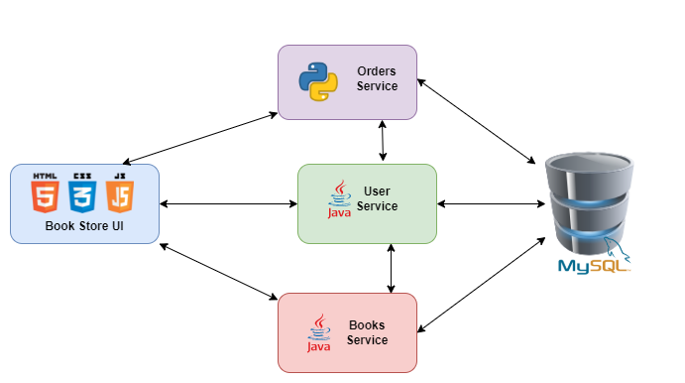
System Architecture
Book Store Application – Microservice architecture

Slide 9
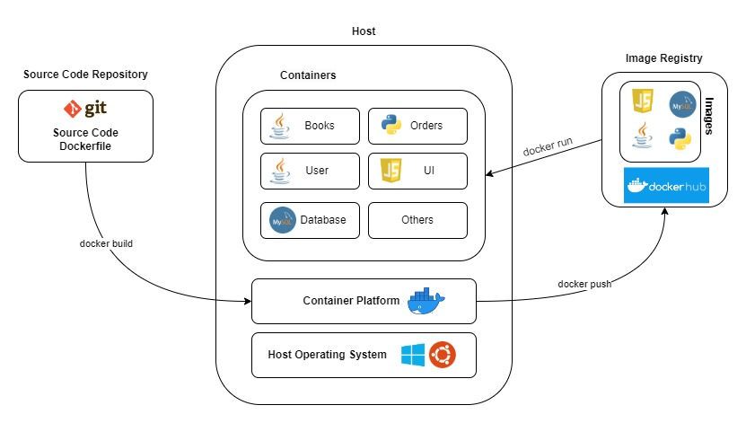
System Architecture
Book Store Application – Docker architecture (on single host)

Slide 10
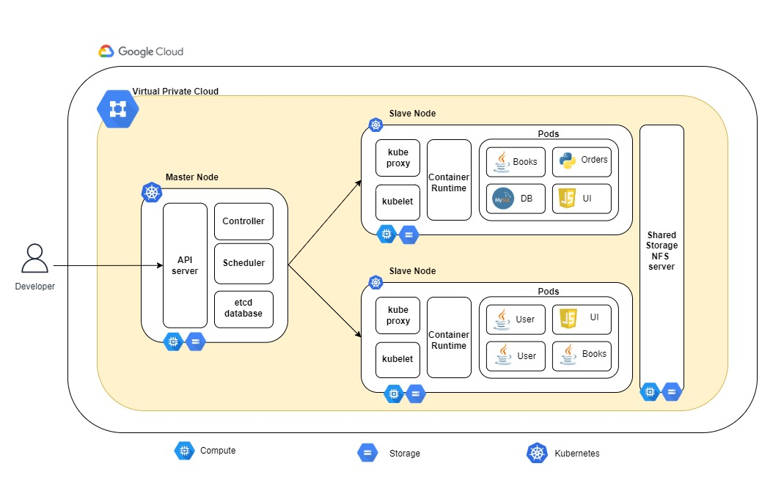
System Architecture
Book Store Application – Kubernetes architecture

Slide 11
How serverless in CI/CD works
Fetch
Test
Build & Package
Upload
Deploy

Slide 12
Serverless CI/CD
Fetch
Test
Build & Package
Upload
Developers
Artifact Repository Servers
Version Control
Build Servers (CI Server)
Production Servers
Deploy Server

Slide 13
Implementation Results
Microservice based polyglot bookstore application is developed.
Containerized to run as docker container on single host.
Deployed the micro service bookstore application on Kubernetes.
Comparison of VM and container environment is done.

Slide 14
Performance Evaluation of VM vs Container
Parameters considered
Boot time
Server footprint
Performance metrics

Slide 15
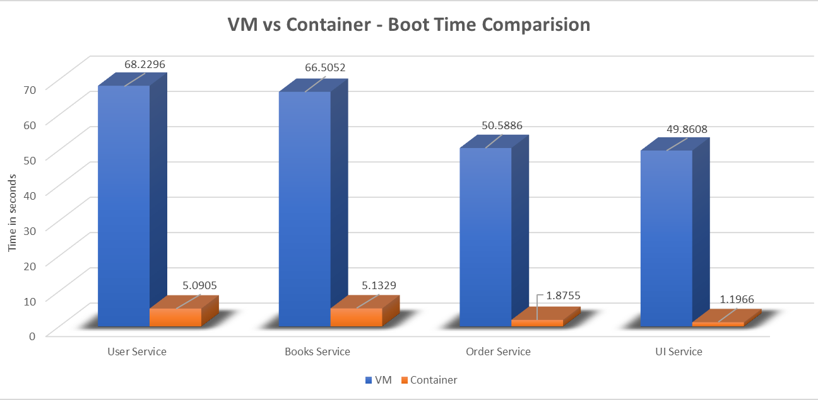
Boot time
Resources allocated
2 core CPU, 2GB RAM
Timestamp collected b/w
VM powered on
Application serving
Timestamp collected b/w
Killing a existing pod
Next pod serving
* All values are mean of 10 observations

Slide 16
Server Footprint

Slide 17
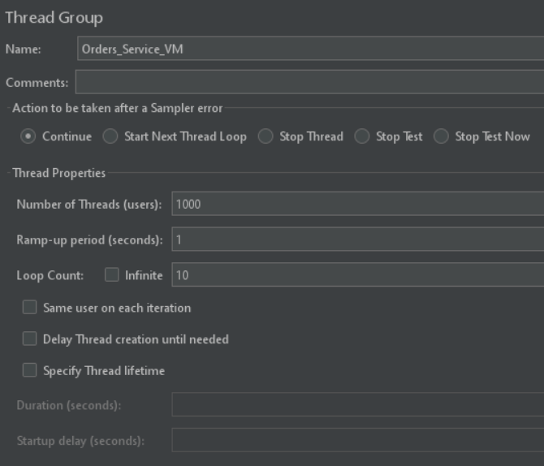
Performance
Metrics
CPU
Memory
Response time
Tools Used
JMeter – For load simulation
Prometheus, Grafana – Monitoring and Visualization
Testing States
Idle - Application is idle
Load – Application under load ( 1000 users, 1s ramp up period, 10 iterations)
Resources allocated for comparison
2 core CPU, 2 GB RAM

Slide 18
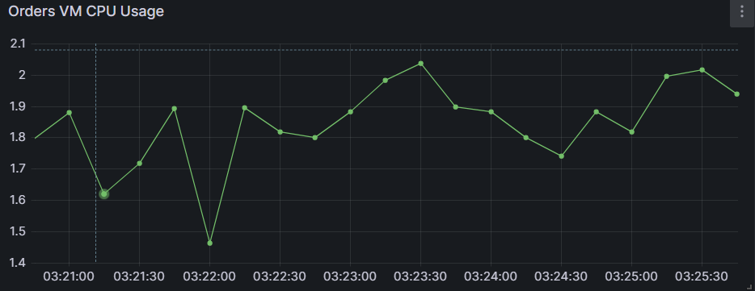
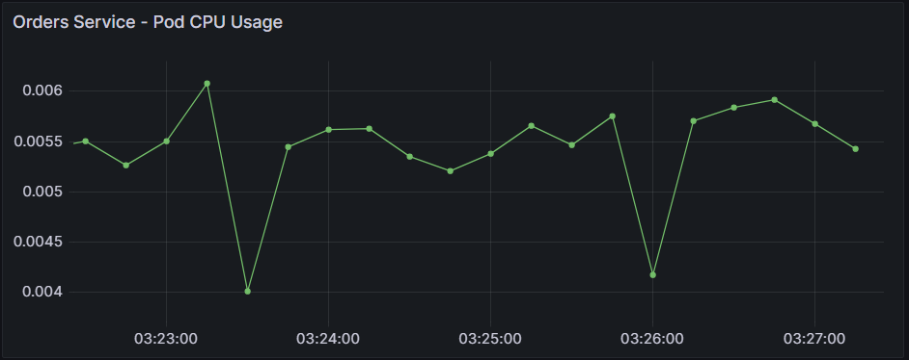
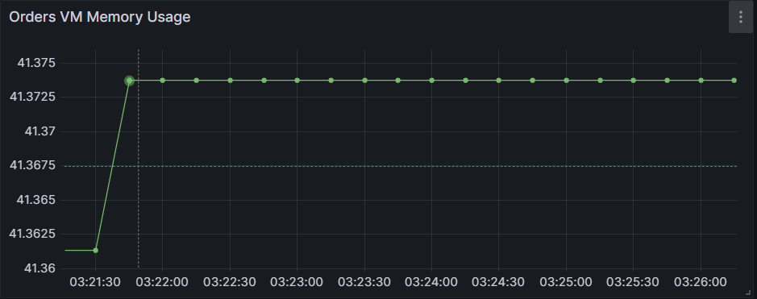
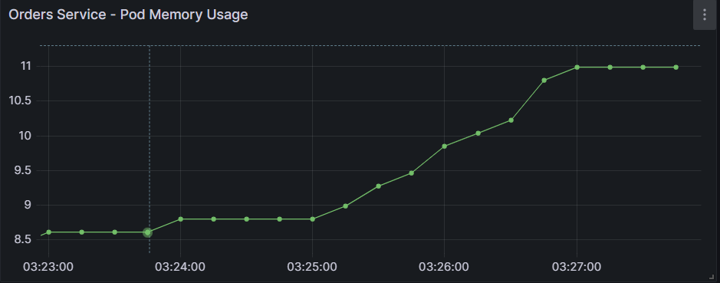
Orders Python Service – Idle State

Slide 19
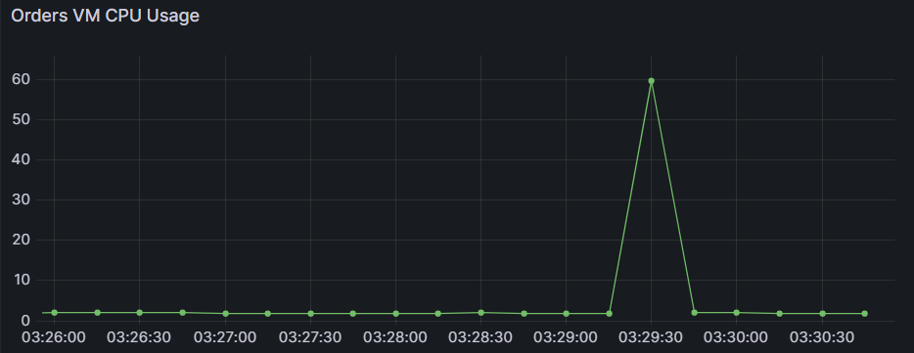
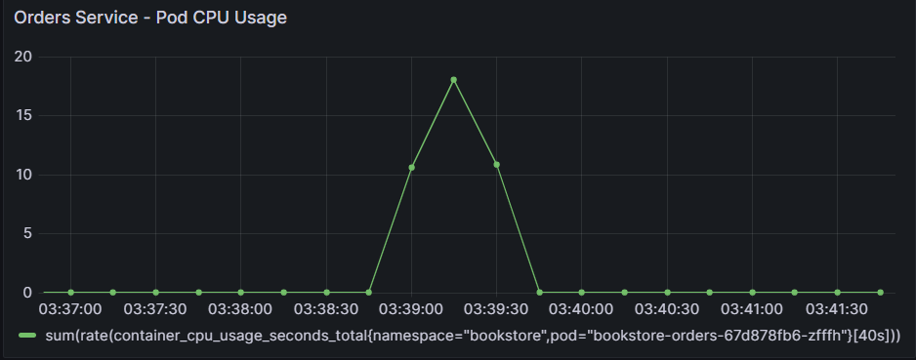
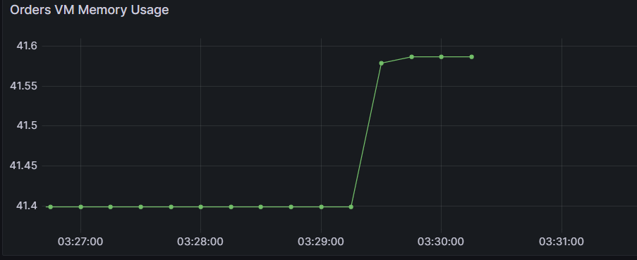
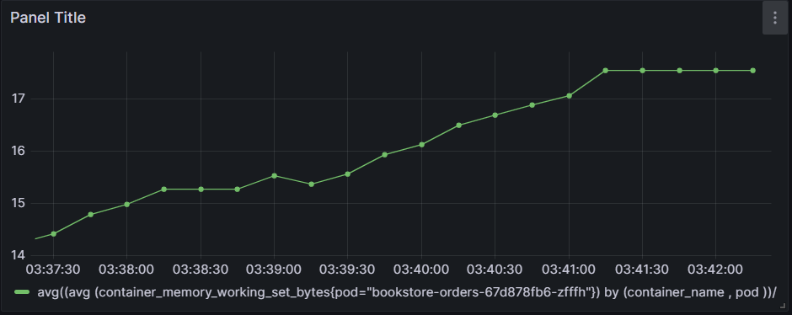
Orders Python Service – Load State

Slide 20
Orders Python Service Response Time
VM
Pod

Slide 21
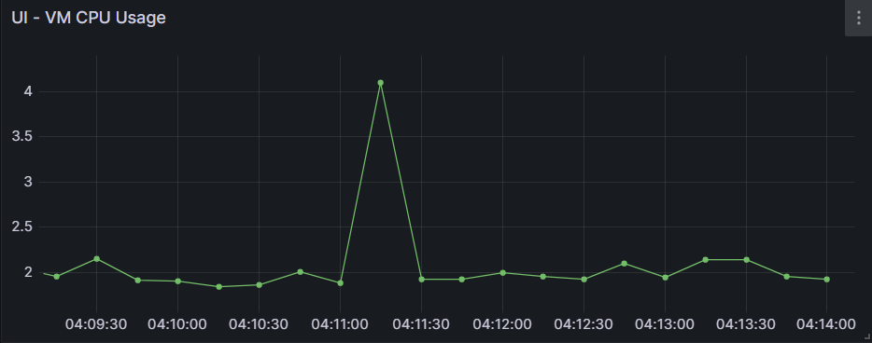
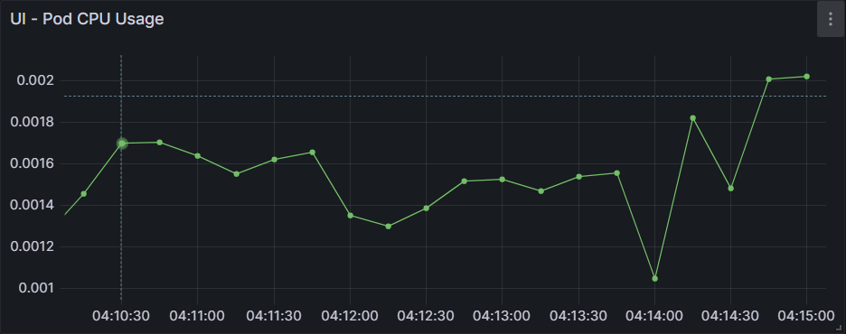
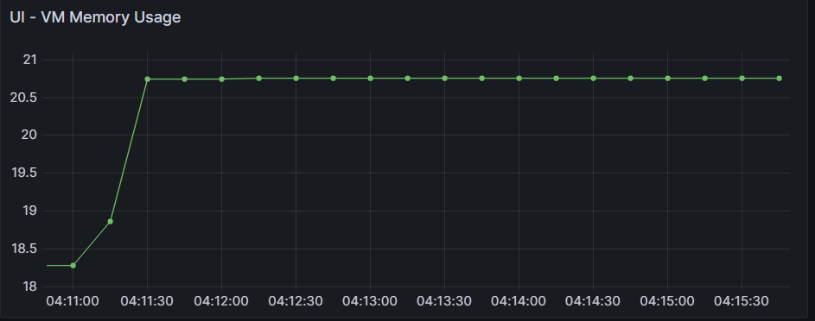
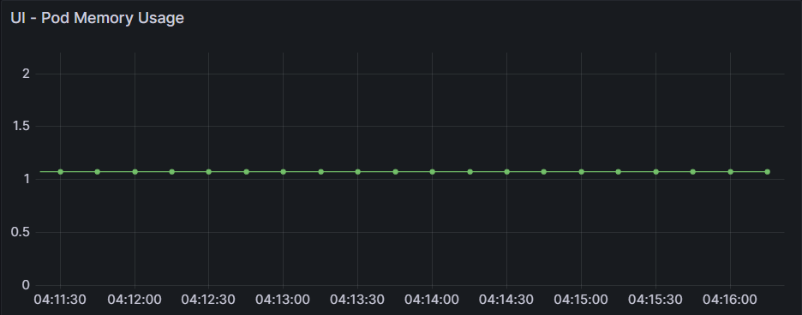
UI JS Service – Idle State

Slide 22
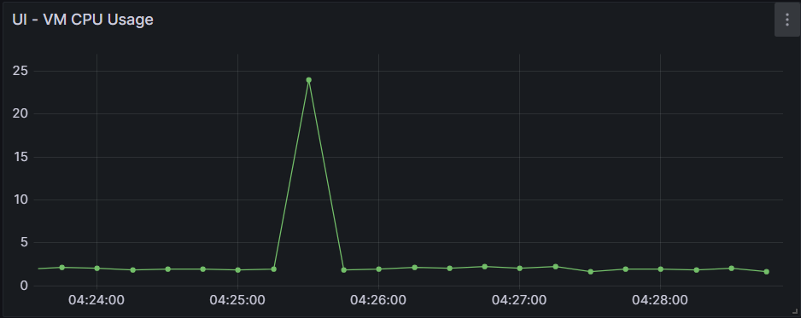
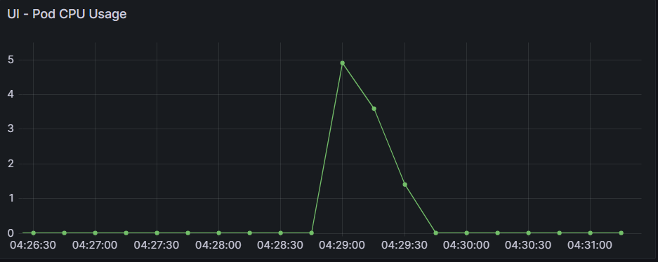
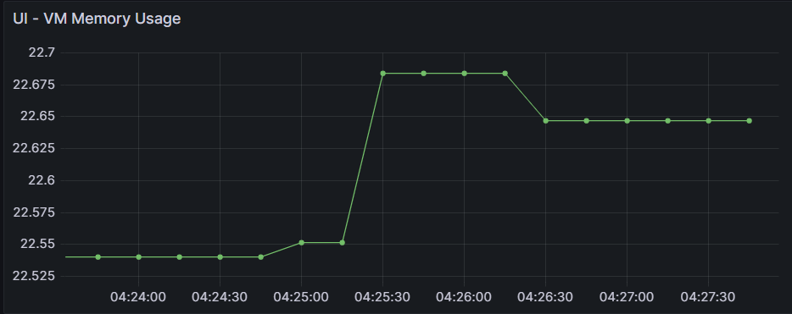
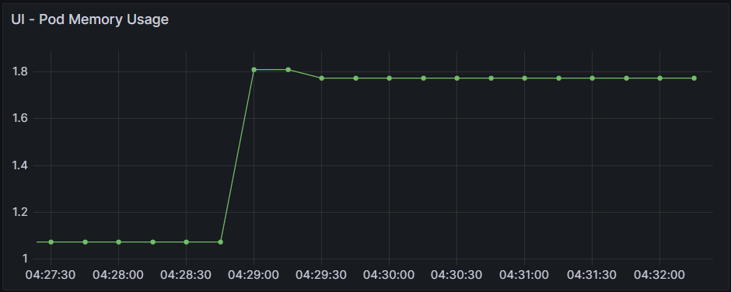
UI JS Service – Load State

Slide 23
UI JS Service Response Time
VM
Pod

Slide 24
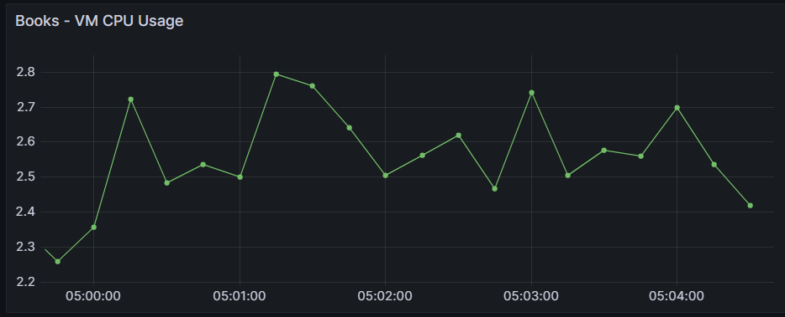
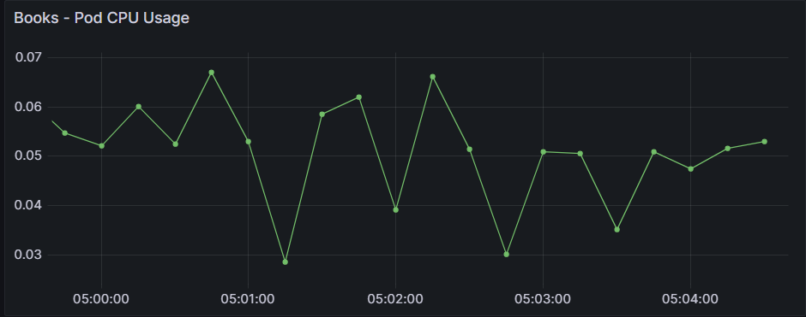
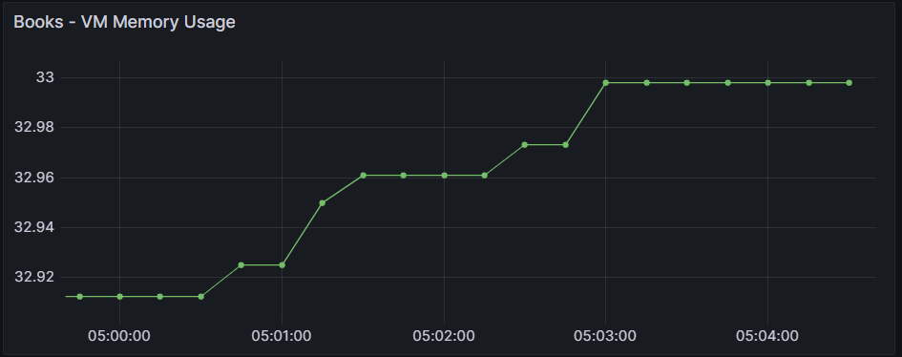
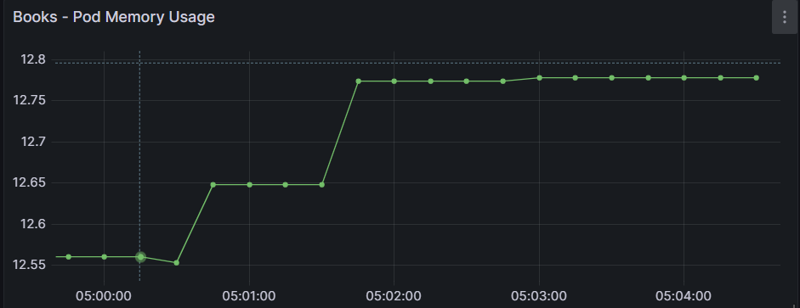
Books Java Service – Idle State

Slide 25
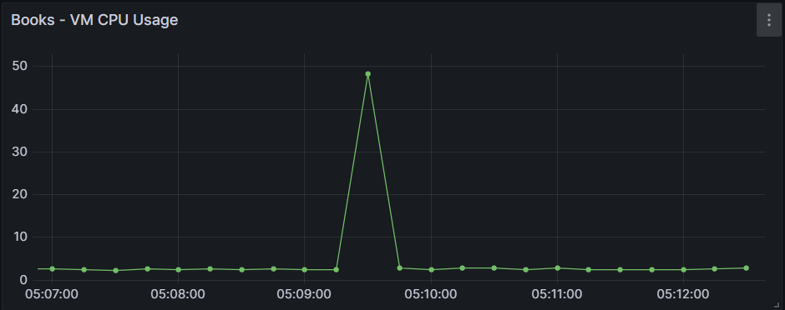
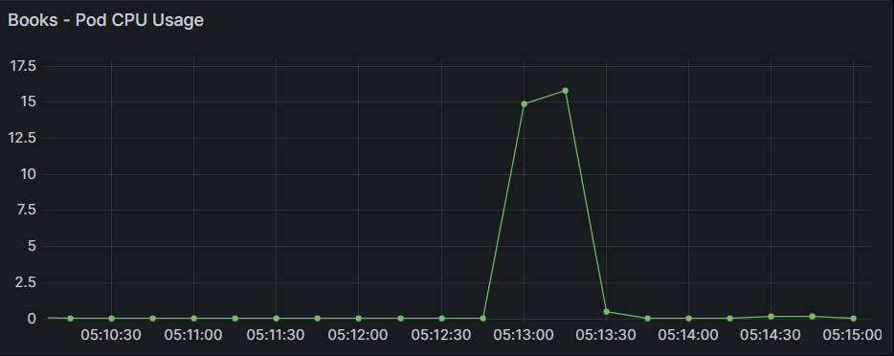
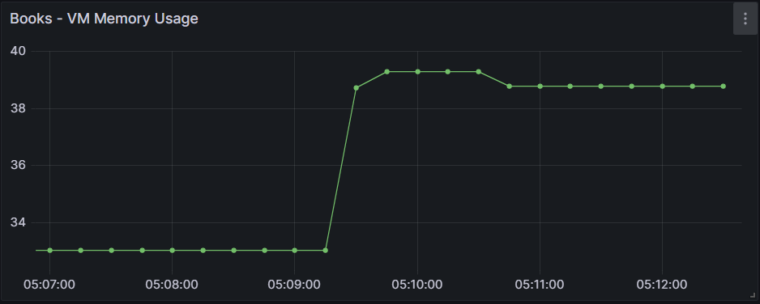
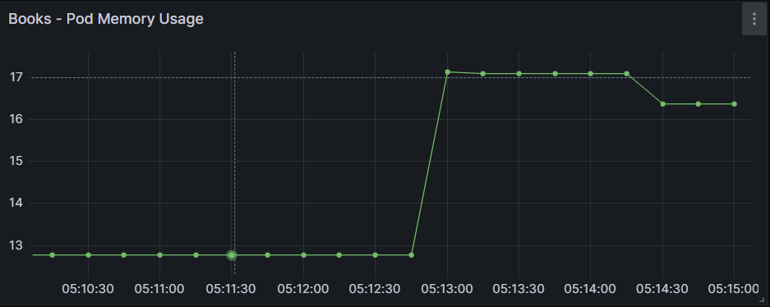
Books Java Service – Load State

Slide 26
Books Java Service Response Time
VM
Pod

Slide 27
Conclusion
Advantages of containers
faster boot time
lower disk usage
lower CPU and memory usage
VMs may be the better choice
that require low response time
strict isolation

Slide 28
Thank You

Slide 29
References
[1] Leila Abdollahi Vayghan, Mohamed Aymen Saied, Maria Toeroe, and Ferhat Khendek. Microservice based architecture: Towards high- availability for stateful applications with kubernetes. In 2019 IEEE 19th international conference on software quality, reliability and security (QRS), pages 176–185. IEEE, 2019.Achieving agility in the development of monolithic applications is challenging.
[2] Vivek Sharma, Harsh Kumar Saxena, and Akhilesh Kumar Singh. Docker for multi-containers web application. In 2020 2nd International Conference on Innovative Mechanisms for Industry Applications (ICIMIA), pages 589–592. IEEE, 2020.Microservices are often set up in traditional virtual machines, leading to issues with conflicting libraries and components.
[3] Guogen Zhang, Kun Ren, Jung-Sang Ahn, and Sami Ben-Romdhane. Grit: consistent distributed transactions across polyglot microservices with multiple databases. In 2019 IEEE 35th International Conference on Data Engineering (ICDE), pages 2024–2027. IEEE, 2019.
[4] Victor Medel, Omer Rana, Jos ́e ́Angel Ba ̃nares, and Unai Arronategui. Modelling performance & resource management in kubernetes. In Proceedings of the 9th International Conference on Utility and Cloud Computing, pages 257–262, 2016.
[5] Marcelo Amaral, Jorda Polo, David Carrera, Iqbal Mohomed, Merve Unuvar, and Malgorzata Steinder. Performance evaluation of microservices architectures using containers. In 2015 ieee 14th international symposium on network computing and applications, pages 27–34. IEEE, 2015.

Slide 30
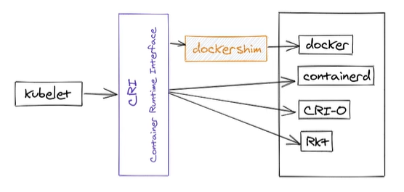
Container - Runtime
Container Runtimes
Containerd

Slide 31
Load Balancing Strategies in K8S service
Round Robin
Least Connection
Destination Hashing
Source Hashing
Shortest expected delay
Never queue
https://technekey.com/changing-the-traffic-distribution-of-a-kubernetes-service/

Slide 32
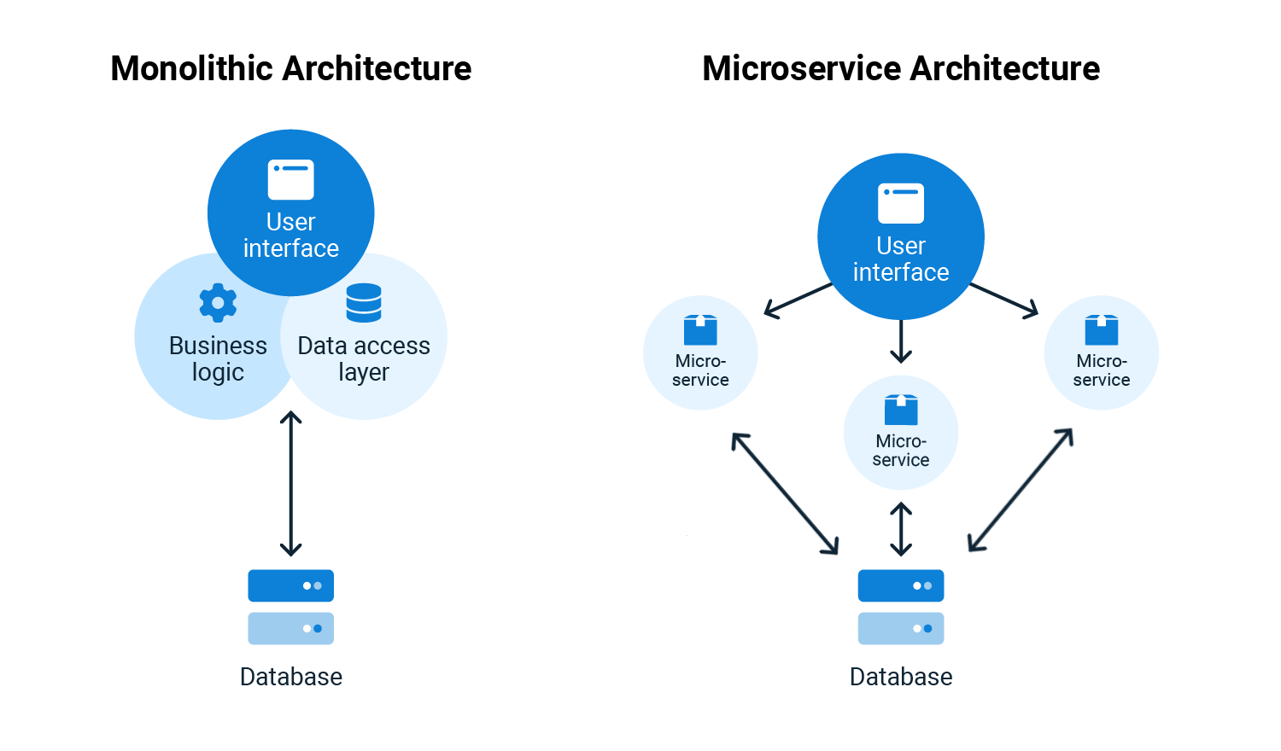
Project Background – Key Concepts
Monolithic and Microservices

Slide 33
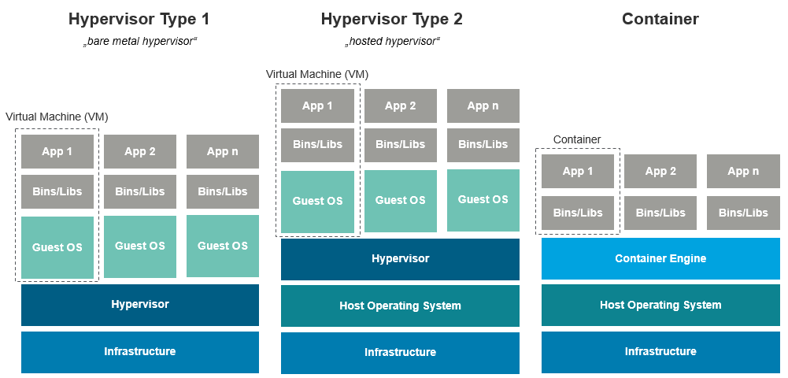
Project Background – Key Concepts
Container : unit of software that packages application and its dependencies
Virtual Machine vs Container

Slide 34

Project Background – Key Concepts
Docker : Tool for container engine
Kubernetes: Tool for container orchestration
App 1
Container
App 2
Container
App 3
Container
App 1
Container
App 2
Container
App 3
Container
Docker
Docker
Host Operating System
Host Operating System
Infrastructure
Infrastructure

Slide 35
Infrastructure
Infrastructure required
physical or virtual machines
storage systems
networking components
Cloud Provider
Google Cloud Platform (GCP)
GCP Services
VPC networks – Virtual Private Cloud Network
Compute Engine – CPU, Memory, Storage for VMs

Slide 36
Related Work
[1] explains the significance of using a microservices-based architecture to implement high availability for stateful applications in Kubernetes.
In [2], emphasized the enhanced portability, scalability, and flexibility of a web application made up of several microservices that each execute in their own container.
The methods for achieving consistent distributed transactions across polyglot microservices that use several databases were covered in [3], that also addressed the challenges of distributed transactions in a polyglot environment.
[4] proposes a validated performance model for Kubernetes clusters that utilizes queueing theory and stochastic processes to optimize resource allocation and enhance cluster efficiency.
[5] compares monolithic and microservices-based applications' performance using Docker containers. The experiments measure response time and throughput under different workloads.

Slide 37
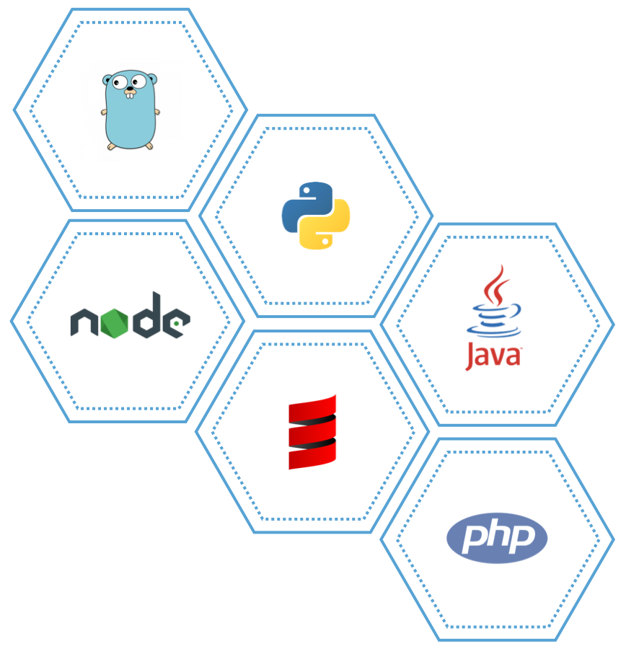
Project Background – Key Concepts
Polyglot Microservices : Developed in multiple programming languages

